Slide 1

Motorized IWB Carts Line Up
Aavara Innovation Corp.

Slide 2
Company Introduction
Make it a better TV
Notes:
<number>

Slide 3
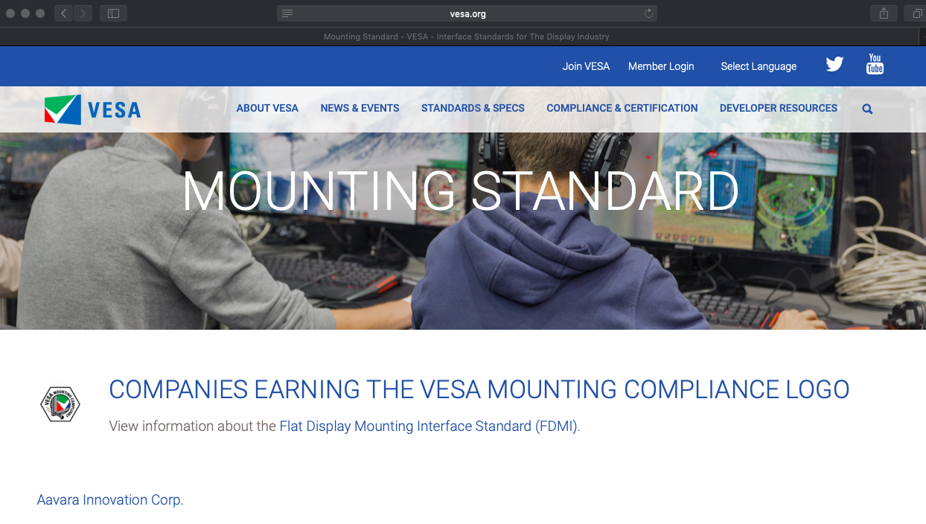
Aavara, A Official VESA Member
& Earns VESA Mounting Compliance Logo
Notes:
<number>

Slide 4
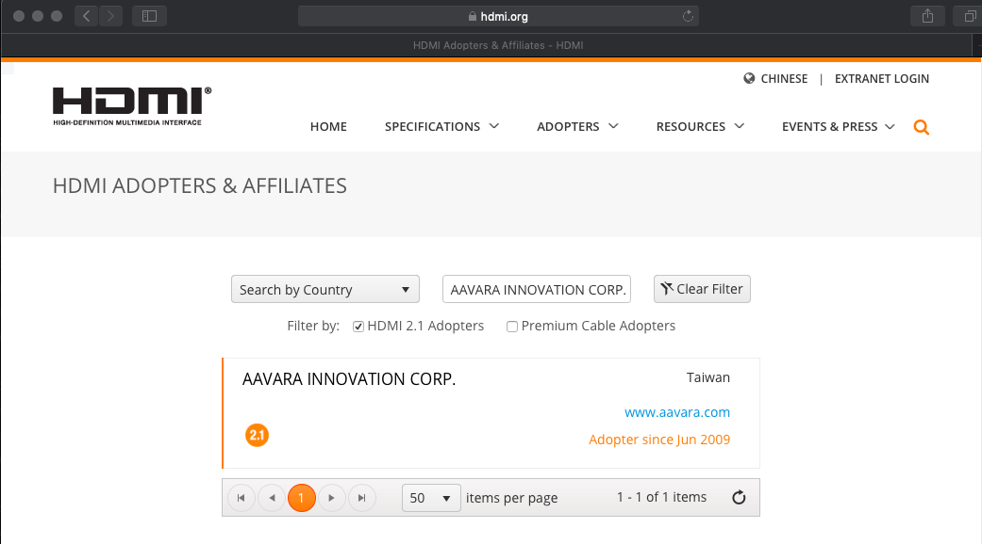
Aavara, A Official HDMI Adopter Since June 2009

Slide 5
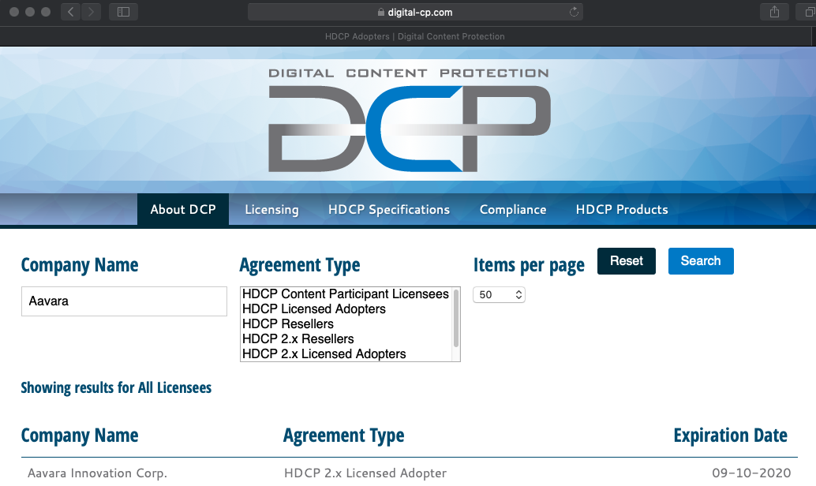
HDCP 2.x Licensee Adopter

Slide 6
Aavara AV Over lP Product Line
Make it a better TV
Notes:
<number>

Slide 7
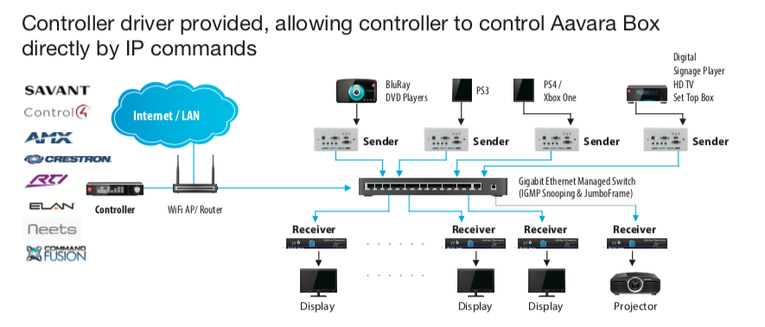
Scalable & Flexible AV Matrix Solution
for Both Commercial & Residential AV
For more information, please visit http://www.aavara.com/V2/PB9000.html
And, some successful projects http://www.aavara.com/V2/globalProject.html

Slide 8
Aavara Mounting Support Product Line
Make it a better TV
Notes:
<number>

Slide 9


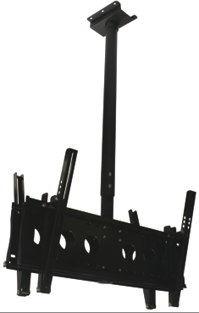



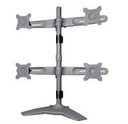
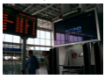

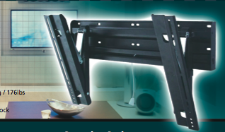
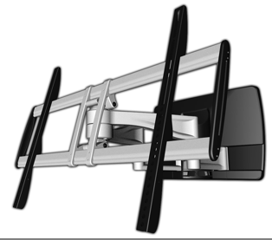
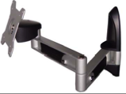
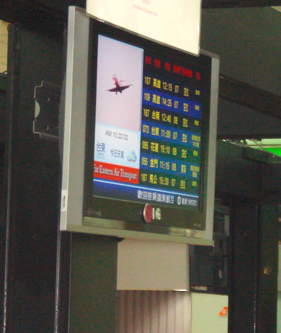
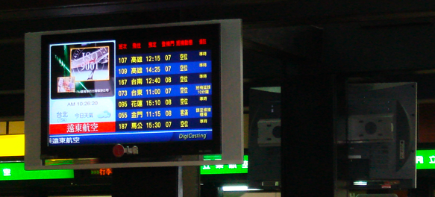
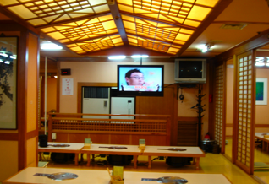
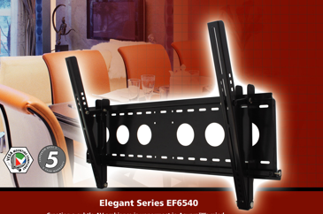
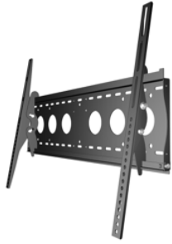
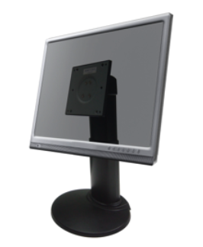
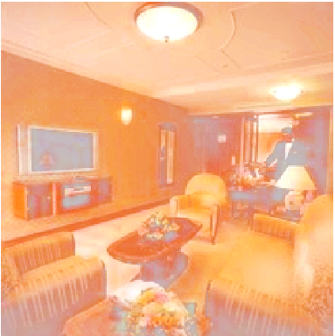
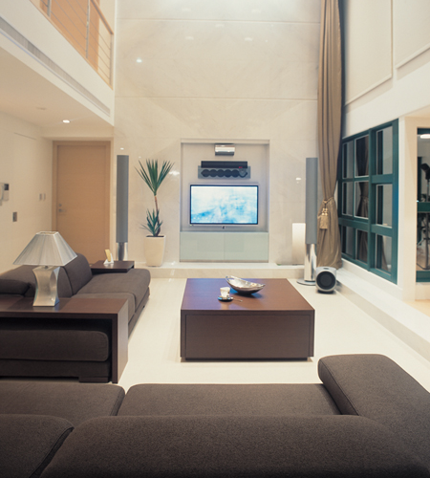

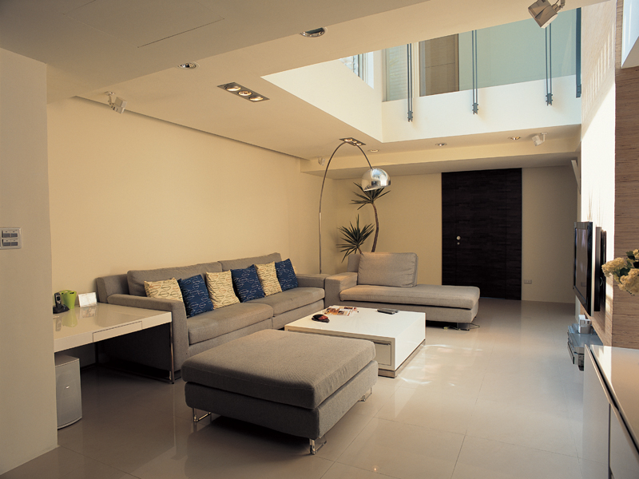
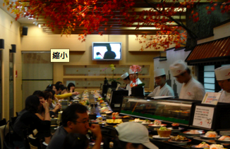
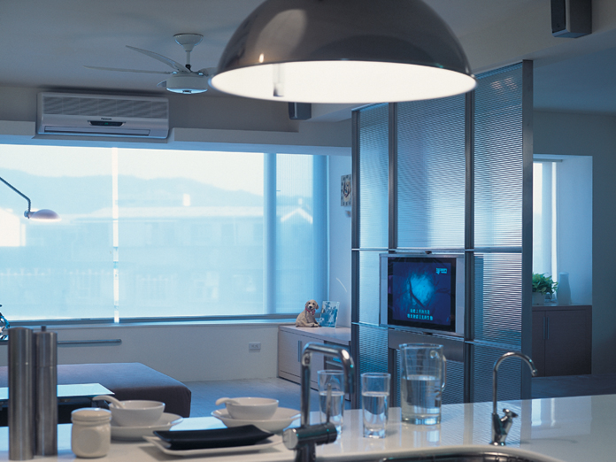
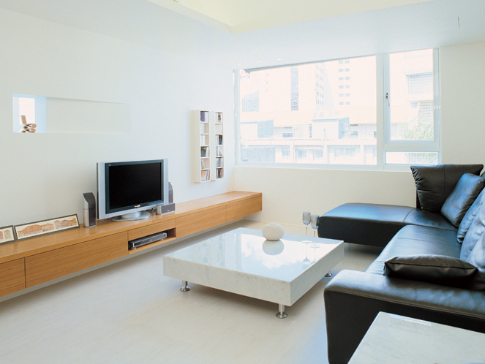
Aavara Mounting Support Line
Menu Board, FID, outdoor, Info. Board, Railway, church,lobby, retail store, shopping malls, Conference Room
Pro Series
Pro Series
cinema, airport, square, public area, luxury house
school, museum, opera house, exhibition signage,
government center, office, shops, amusement
Pricing & Uniqueness
Superior Series
Living room, bed room, home office, home theater, amusement room
Dining room, kitchen, playroom
Elegant Series
Popularity & Universal
For more information, please visit http://www.aavara.com/V2/index.html
And, some successful projects http://www.aavara.com/V2/globalProject.html
Notes:
<number>

Slide 10
Aavara IWB Trolley Cart Proposal
Make it a better TV
Notes:
<number>

Slide 11
IWB Carts Line Up
Model | Description | Max. Display Weight Loading | Height LIFT | Tilt | < 30 pcs Ex-Work Price | ≥ 30 pcs Ex-Work Price
CDT860M | Current Model | 120Kgs | Yes, 500mm | 0⁰ ~ 90⁰ Motorized adjust, free angle | $1,050 | $999
CDT861M New! | Same ID Design as CDT860M without Tilt Motor Mechanism | 120Kgs | Yes, 500mm | 0⁰ or 90⁰ Manual adjust, fixed angle | $985 | $869
CDT860E New! | Motorized Up/Down Height Adjustment Only | 80Kgs | Yes, 455mm | N/A | $650 | $587
* All Models come with 800x600mm Mounting Support.

Slide 12
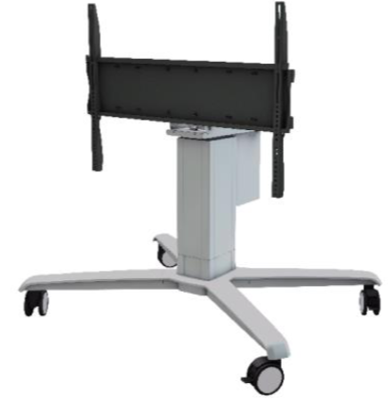
CDT861M
Motorized LIFT & Tilt IWB Cart

Slide 13
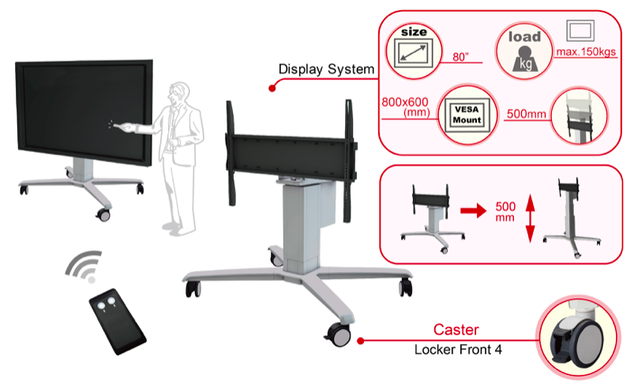
CDT861M Features
* Optional Platform Support kit!

Slide 14
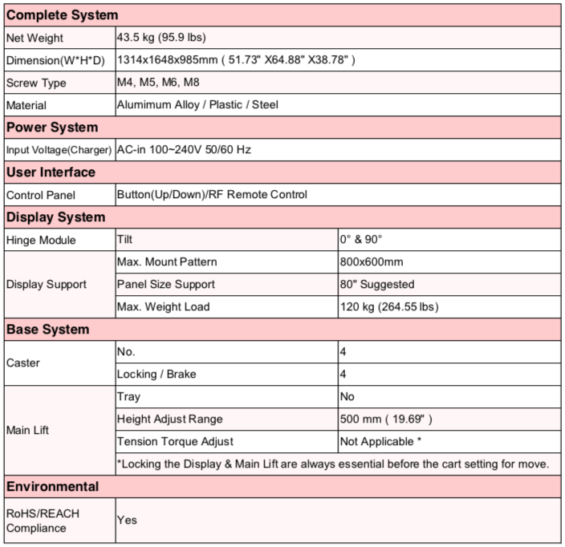
CDT861M Specification
* Optional Platform Support kit!

Slide 15
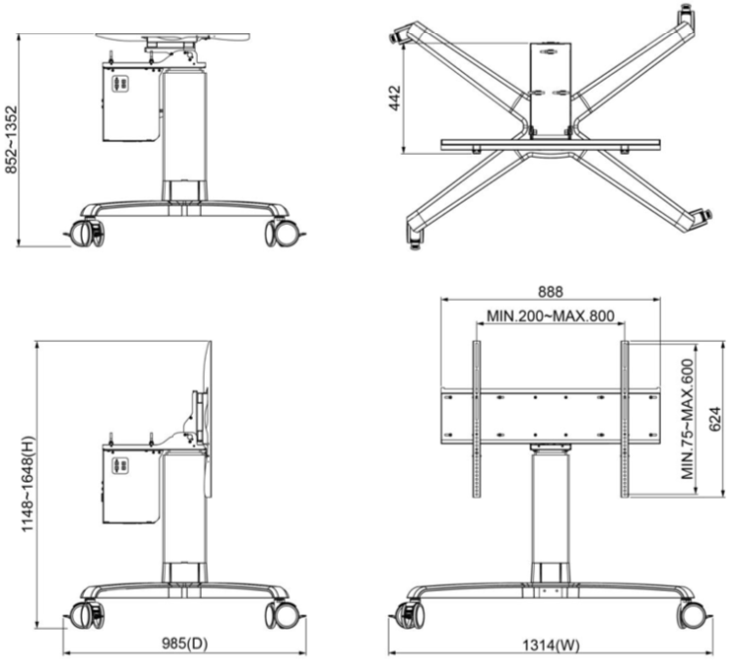
CDT861M Dimensions
* Optional Platform Support kit!

Slide 16
CDT860E
Motorized LIFT IWB Cart

Slide 17
CDT860E Features
* Optional Platform Support kit!

Slide 18
CDT860E Specification
* Optional Platform Support kit!

Slide 19
CDT860E Dimensions
* Optional Platform Support kit!

Slide 20
Thanks You!
Aavara Innovation Corp.

