Slide 1


Nick Hsu
Aavara Technical Director
Notes:
1

Slide 2
Aavara® Mounting system
Notes:
2
2

Slide 3
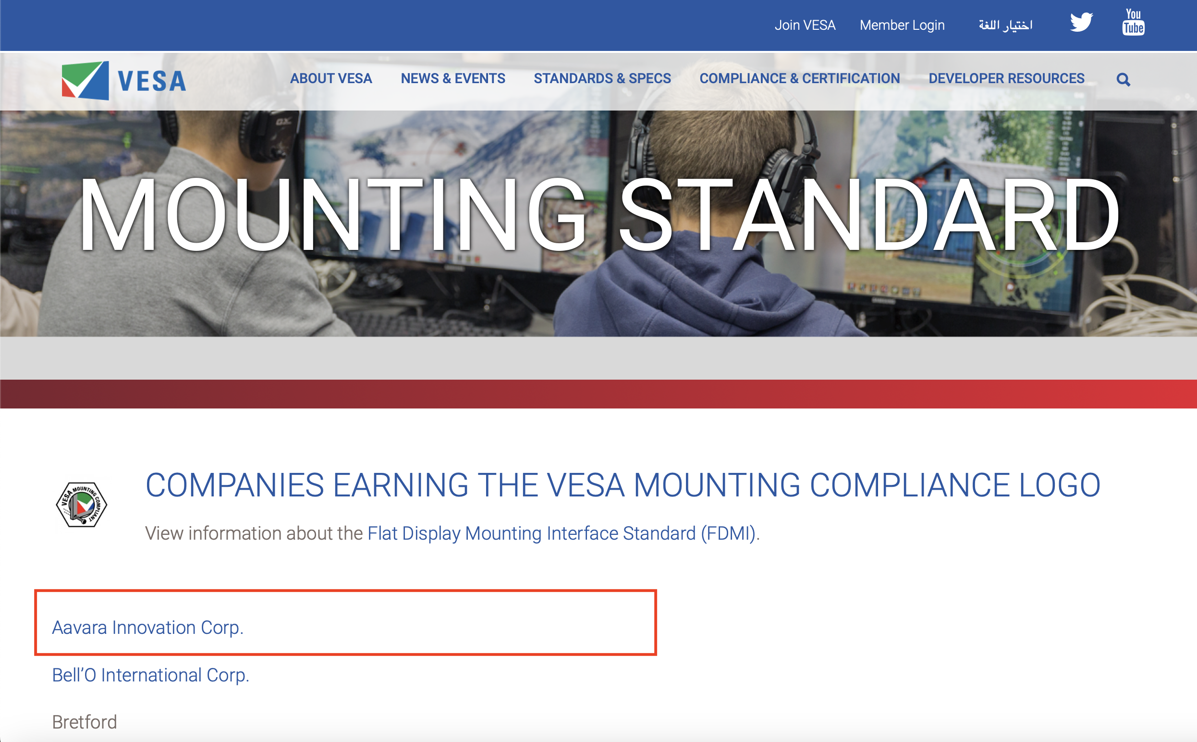
Aavara Earning VESA Mounting Compliance Logo

Slide 4




Slide 5


Why AV over IP?
The Future of Signal Routing & Control
Utilize IP network standard
Industry widely adoption
Sending AV signals
(audio, video, control, power)

Slide 6






Widely deploy across
1. Commercial
2. Educational
3. Residential
4. Entertainment
5. E-gaming
6. Hospitality…

Slide 7
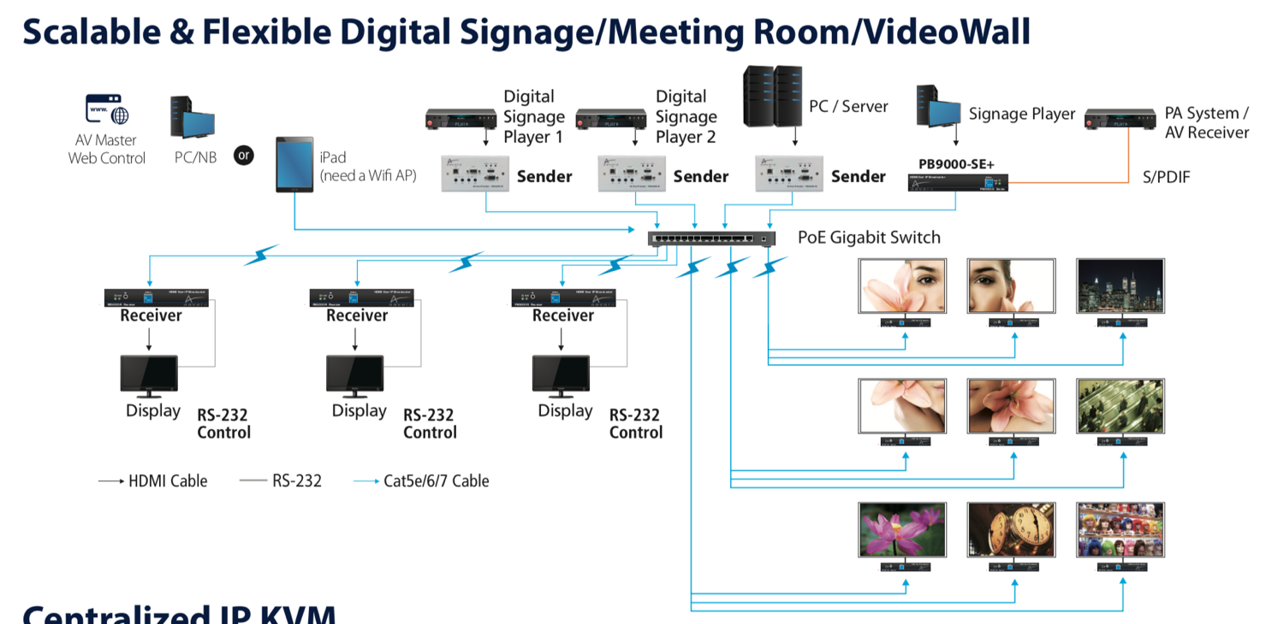
Aavara AV Over IP
Commercial Installation
Notes:
7
7

Slide 8
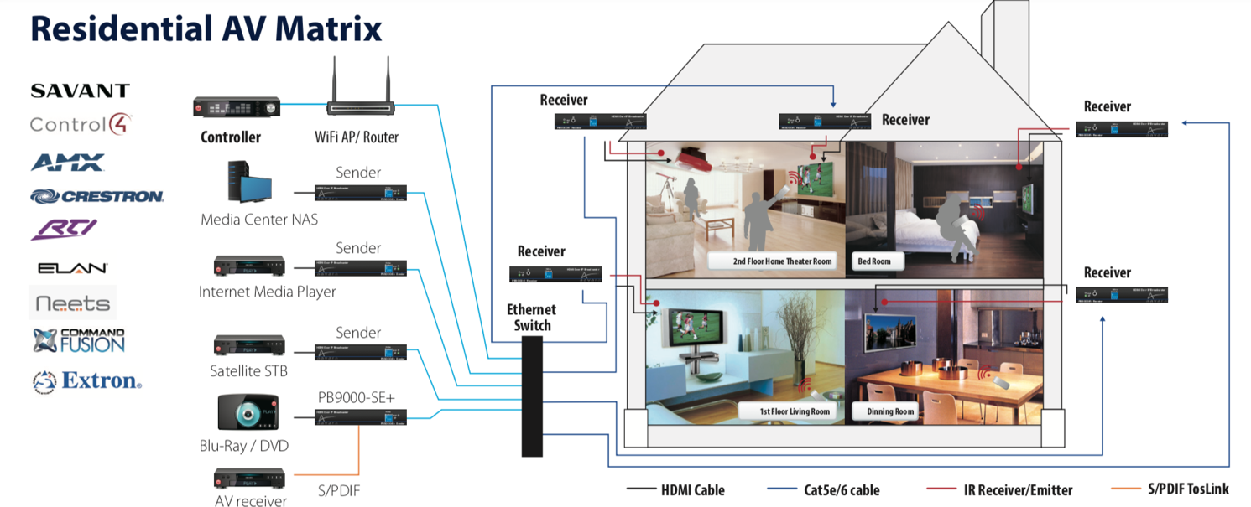
Aavara AV Over IP
Residential AV Installation
3rd Party Controller Integration
Notes:
8
8

Slide 9
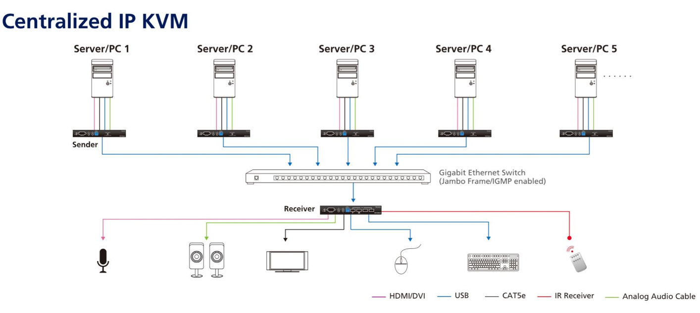
Aavara AV Over IP
USB IP KVM
Notes:
9
9

Slide 10
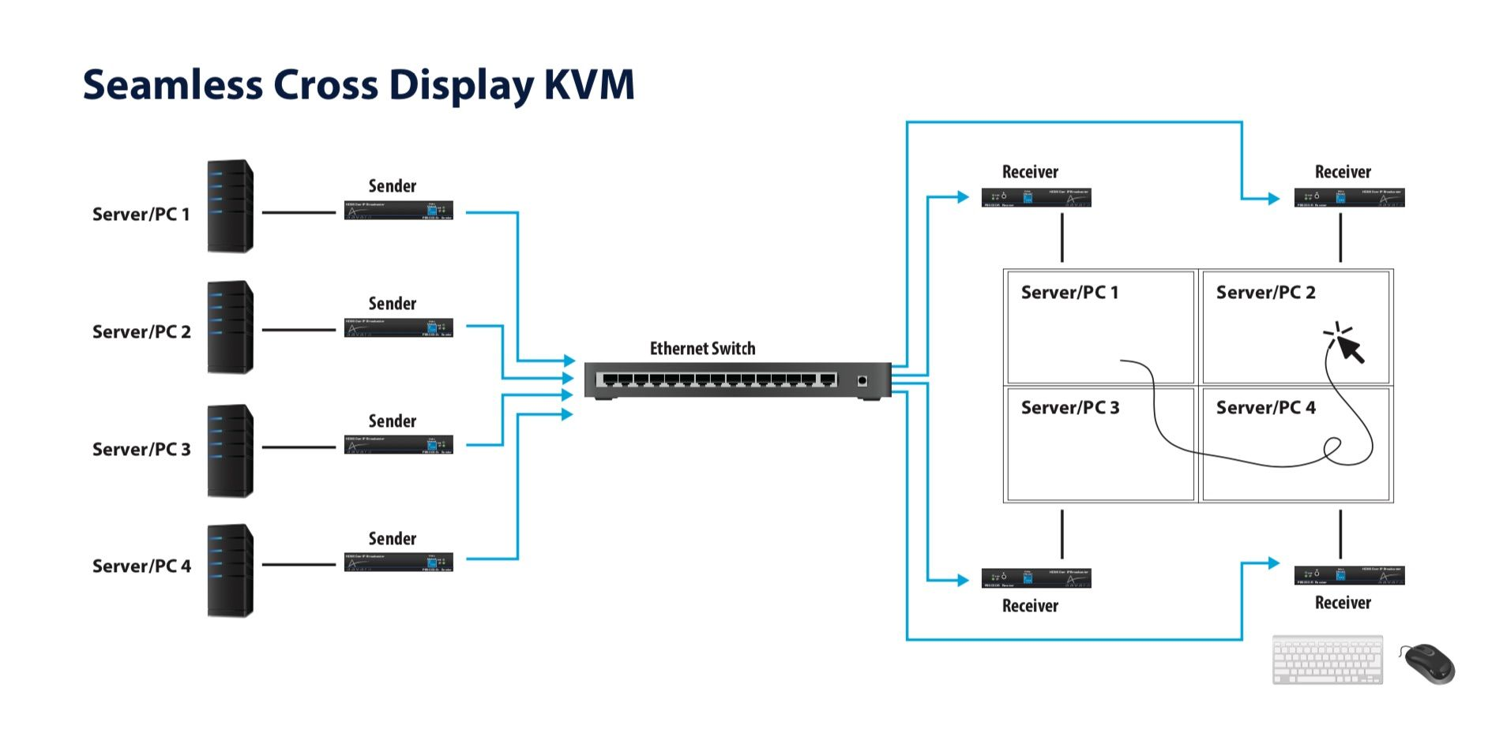
Aavara AV Over IP
Seamless Cross Display KVM
Notes:
10
10

Slide 11
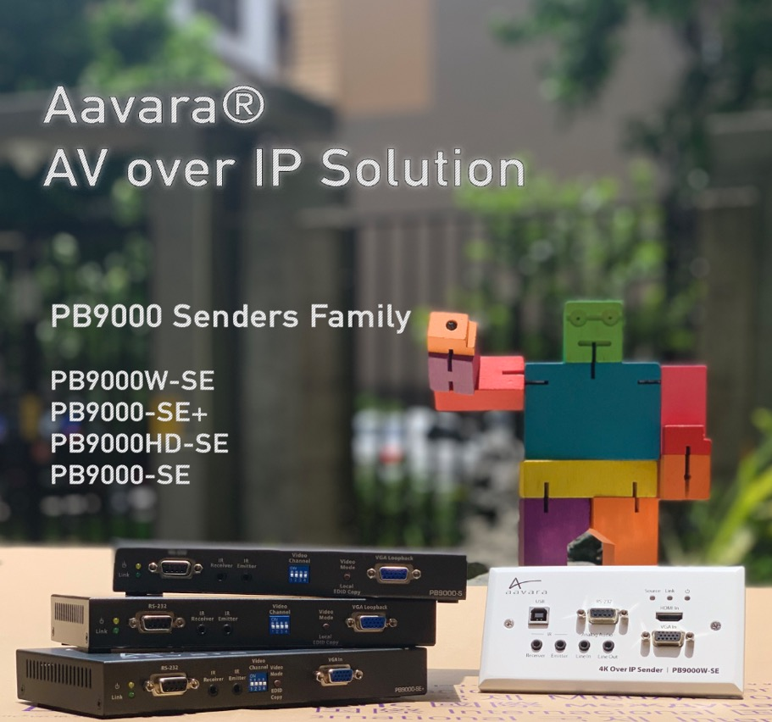
4K60 4:2:0 Over 1 GbE
PB9000
Notes:
11
11

Slide 12
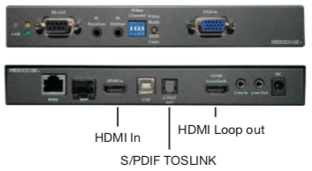
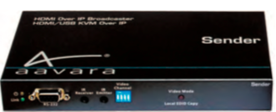
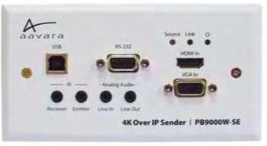
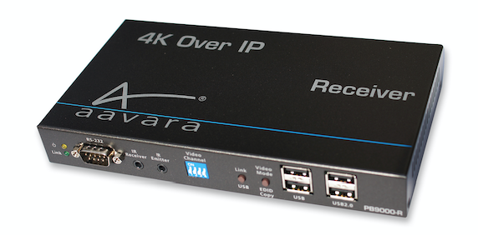
PB9000 4K60 4:2:0 Over IP
PB9000-SE+H
- 4K Over IP Sender with HDMI In, HDMI Loopout, S/PDIF Fiber Digital Audio out
PB9000HD-SE
- 1080p Over IP Sender with HDMI/VGA dual input
- Work with PB9000-RE receiver that convert 1080p input to 4K output
PB9000W-SE
- 4K Over IP Wall Plate Sender, EU Wall Plate form factor, HDMI/ VGA dual Input
- PoE power only
PB9000-RE
- 4K Over IP receiver with HDMI/VGA dual output
Notes:
12
12

Slide 13
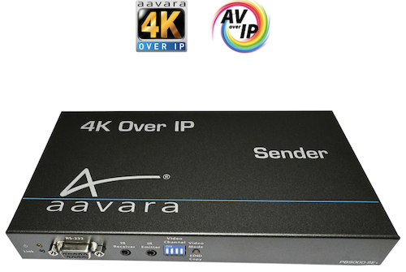
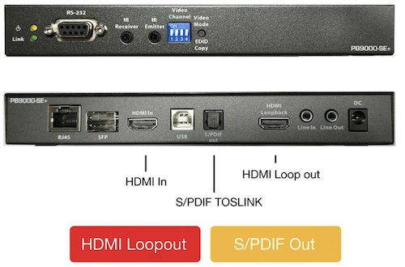
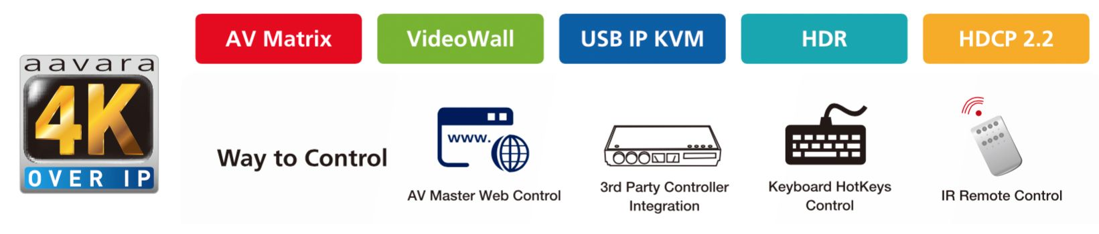
PB9000 4K Over IP Sender
PB9000-SE+H
Notes:
13
13

Slide 14

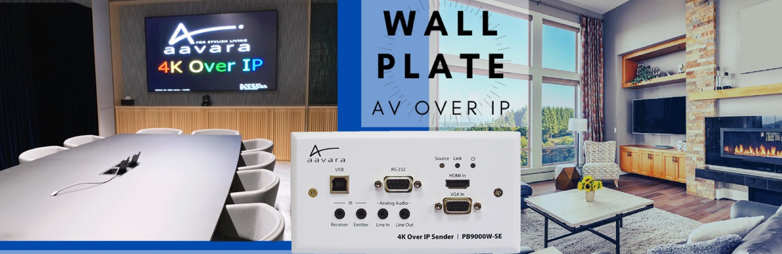
Notes:
14
14

Slide 15
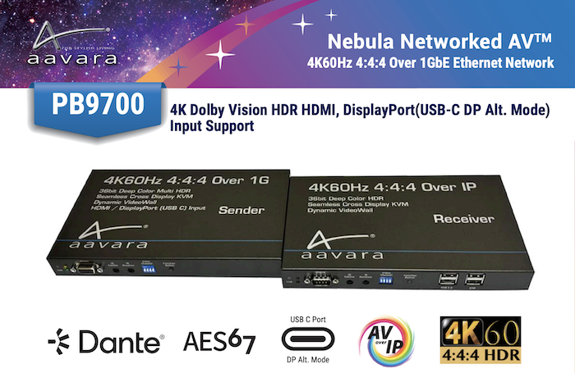
4K60 4:4:4 Over 1GbE
PB9700

Slide 16
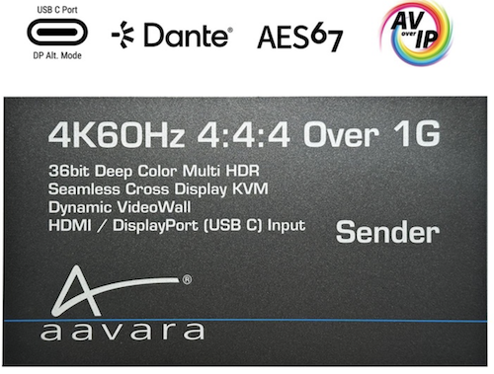
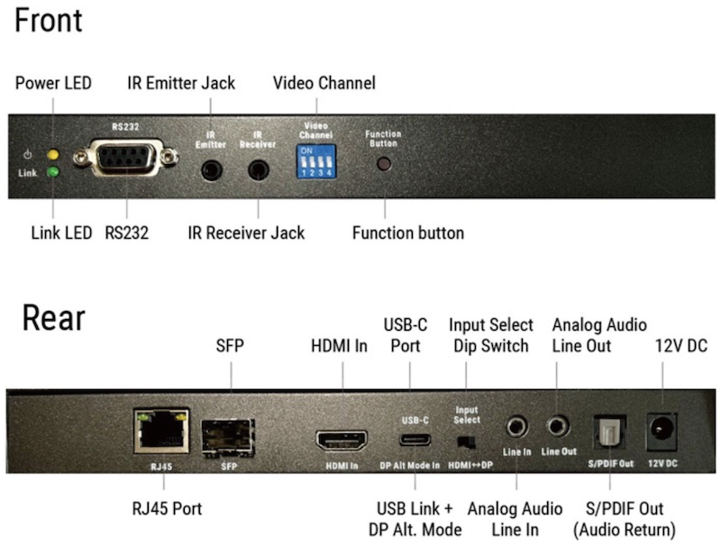
4K60 4:4:4 Over 1GbE
PB9700-SE Sender

Slide 17
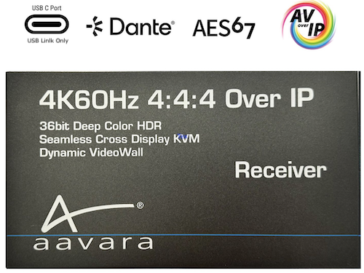
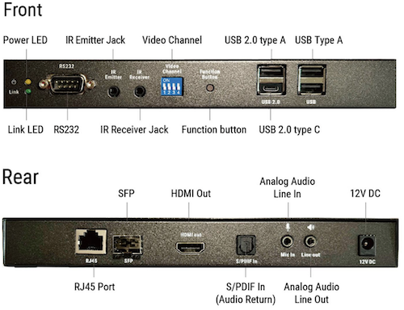
4K60 4:4:4 Over 1GbE
PB9700-RE Receiver

Slide 18
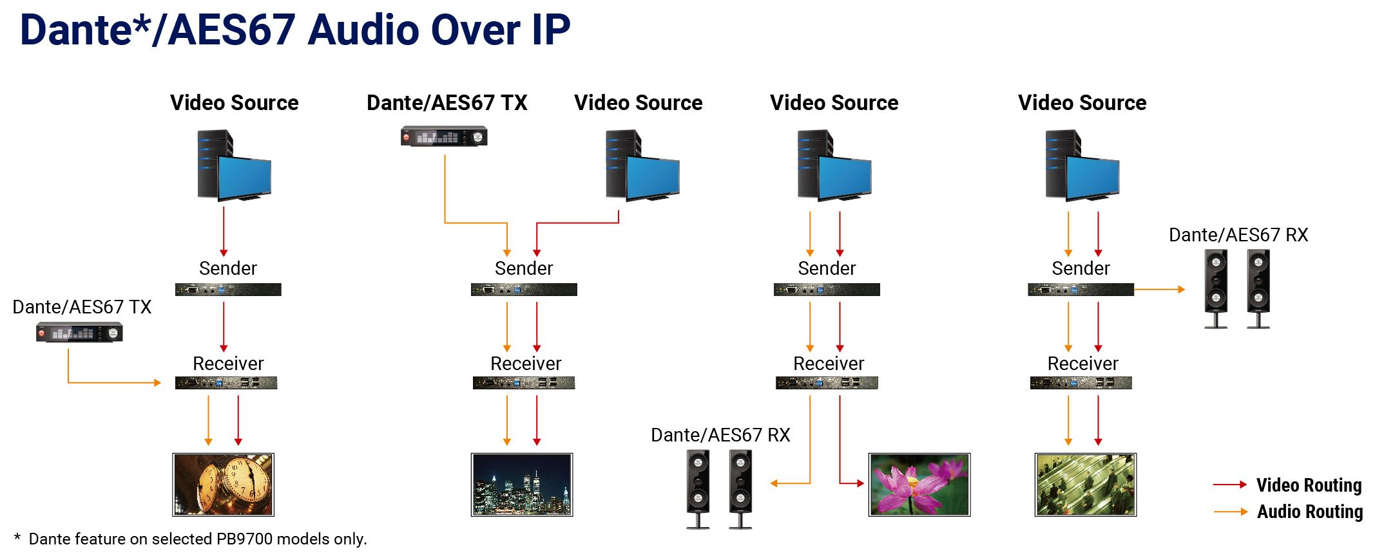
Aavara AV Over IP
Commercial AV Installation
Networked Video + Networked Audio integration made easy!
Notes:
18
18

Slide 19
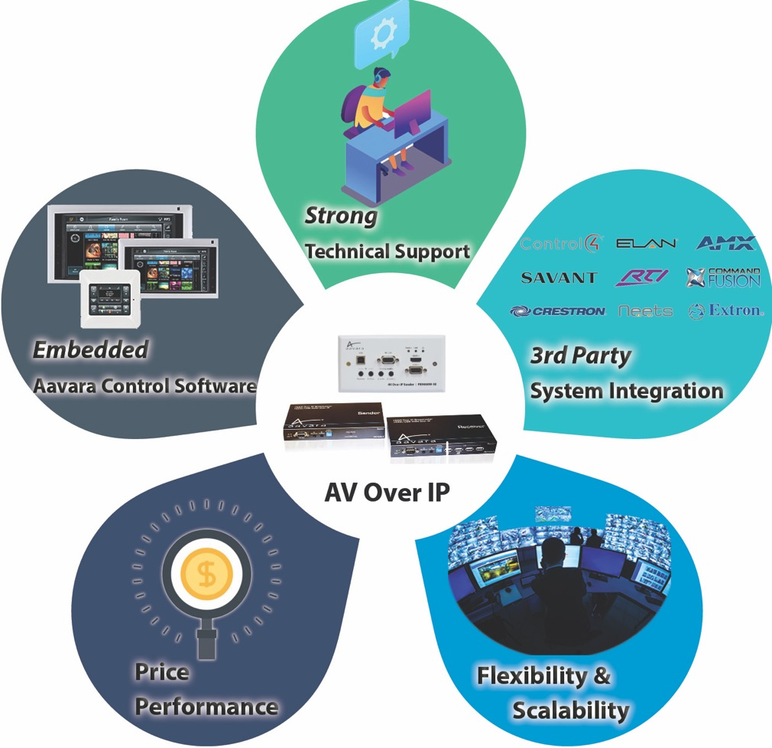

Why Aavara® AV over IP Solution?
⭐️⭐️⭐️⭐️⭐️

Slide 20
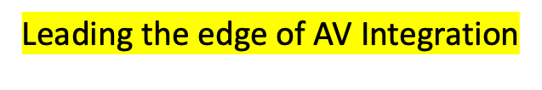
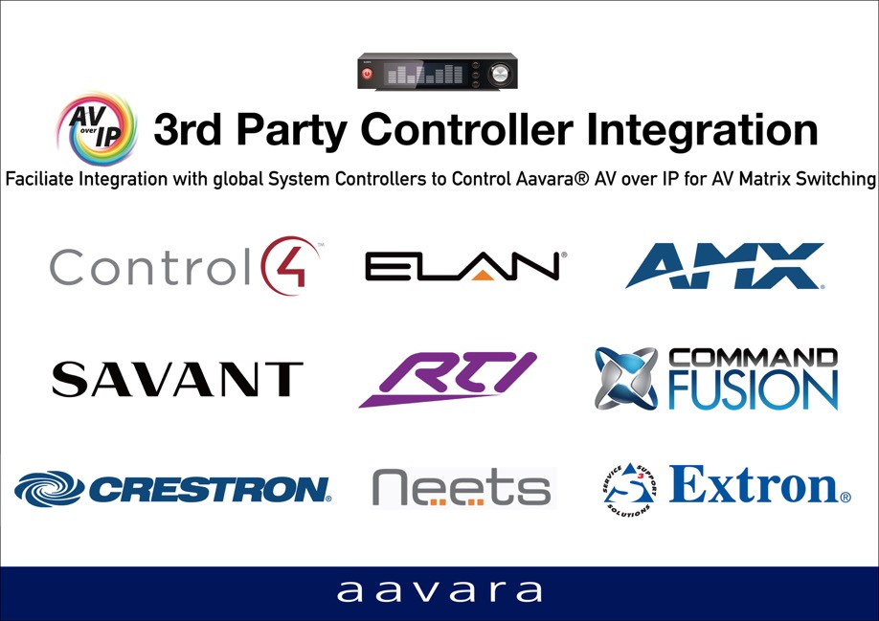


Why Aavara® AV-over-IP Solution?
✅ A Proven
✅ Field Tested
✅ Global cases study
✅ Best Interoperated With
Leading System Controllers

Slide 21
AV Master Web control
Setup in Ms Excel
Notes:
21

Slide 22
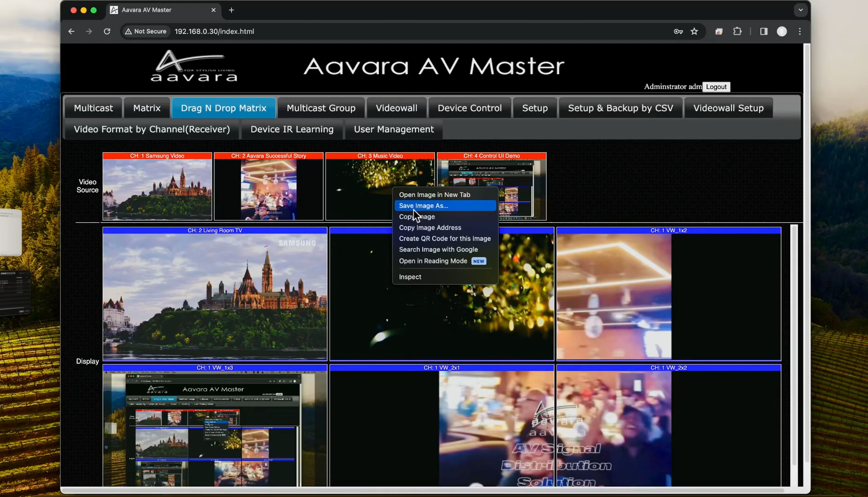
Aavara AV Master Web Control
Dante Controller/DDM Control

Slide 23
Good Products need Great Partner.

Slide 24


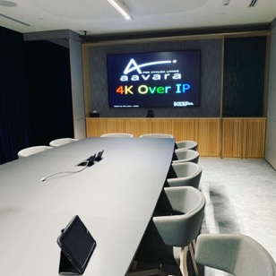




Thank You
www.aavara.com
Notes:
24
24
24

